Slide 1
ENTREPRENUERSHIP

Slide 2
Entrepreneurship
Entrepreneurship is the act or process of being an entrepreneur, which can be defined as: One who undertakes innovations, finance and business wisdom in an effort to transform innovations into economic goods.
Entrepreneurship can create new organizations or develop a strategy to revitalize mature organizations in response to a perceived opportunity.
No society can exist without entrepreneurship. Every society depends on entrepreneurs.

Slide 3
Definition of 'Entrepreneur'
An individual who, rather than working as an employee, runs a small business and assumes all the risk and reward of a given business venture, idea, or good or service offered for sale.
Dan Sullivan Says that: “An entrepreneur is someone who does not expect compensation until he has created value for someone else.”
Jean-Baptist Say, Says that: “Entrepreneur is someone who takes resources from a lower level of productivity and raise them to a higher level.”

Slide 4
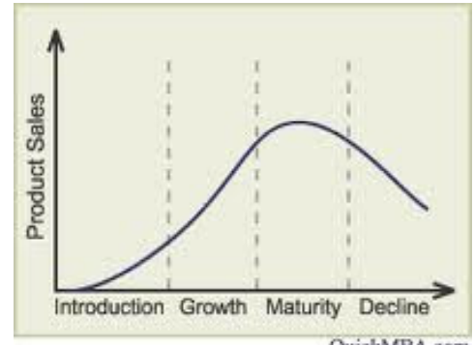
Major obstacles in starting a company and becoming entrepreneur
The life cycle of any business has four stages:
1. Starting a business
2. Staying in business
3. Growing a business
4. Exiting a business.

Slide 5
Major obstacles in starting a company and becoming entrepreneur
At every stage, companies and entrepreneurs face numerous obstacles. Each stage has different challenges. For example, a player who is new to a sport will have different challenges a player with 10 years of experience.
In the startup stage, a company might be dealing with issue like funding, pricing a product, or strategies for service delivery.
In the growing stage, the business look for new entry points or acquire a competitor to gain a bigger market share.
Personal and business obstacles are also part of the game. Just like wind or rain are part of a football game, obstacles are part of our lives. Entrepreneurs must accept this as a fact and learn how to overcome whatever life presents.

Slide 6
Characteristics of an Entrepreneur
The characteristics of entrepreneurs are numerous? a successful entrepreneur possesses a combination of traits that show both innovation and leadership qualities.
Ambition.
Creativity.
Decision-making.
Passionate and others.

Slide 7
Entrepreneur vs. manager:
The terms Entrepreneur and Manager are considered one and the same. But the two terms have different meanings·
The main reason for an entrepreneur to start a business enterprise is because he comprehends the venture for his individual satisfaction and has personal stake in it where as a manager provides his services in an enterprise established by someone.
An entrepreneur and a manager differ in their standing, an entrepreneur is the owner of the organization and he bears all the risk and uncertainties involved in running an organization where as a manager is an employee and does not accept any risk.

Slide 8
Role of Entrepreneurship in economic development
The entrepreneur who is a business leader looks for ideas and puts them into effect in fostering economic growth and development.
He plays a pivotal role not only in the development of industrial sector of a country but also in the development of farm and service sector.
The major roles played by an entrepreneur in the economic development are as follows:

Slide 9
Role of Entrepreneurship in economic development
(1) Promotes Capital Formation:
Entrepreneurs promote capital formation by mobilizing the idle savings of public. They employ their own as well as borrowed resources for setting up their enterprises. Such types of entrepreneurial activities lead to value addition and creation of wealth, which is very essential for the industrial and economic development of the country.

Slide 10
Role of Entrepreneurship in economic development
(2) Promotes Balanced Regional Development:
Entrepreneurs help to remove regional disparities through setting up of industries in less developed and backward areas. The growth of industries and business in these areas lead to a large number of public benefits like road transport, health, education, entertainment, etc.

Slide 11
Role of Entrepreneurship in economic development
(3) Increasing Gross National Product and Per Capita Income
Entrepreneurs are always on the look out for opportunities. They explore and exploit opportunities,, encourage effective resource mobilization of capital and skill, bring in new products and services and develops markets for growth of the economy.

Slide 12
Opportunities for entrepreneurs
There is certainly no formula to become a successful entrepreneur. Some may succeed and make good profits, others sink along the way.
Here's a list of good opportunities entrepreneurs can look at:
Tourism
Software
Textiles
Social ventures(NGOs)

